Slide 1
URLs Classification
Ivan Sarno
AI for Cybersecurity
08/06/2022

Slide 2

The Problem
Classification of Web requests using only the URL.

Slide 3
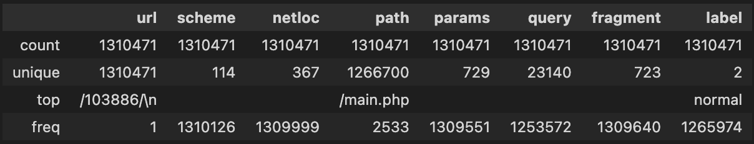
Dataset
Duplicates removal
URL parsing

Slide 4
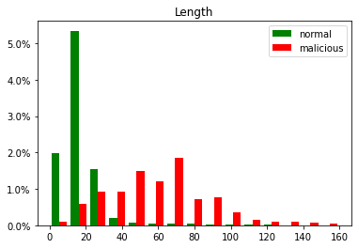
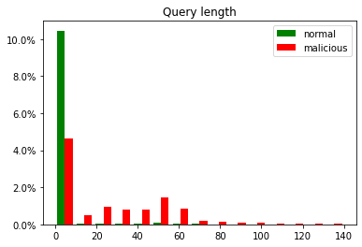
Approach 1: features

Slide 5
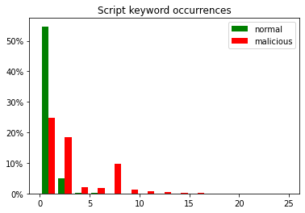
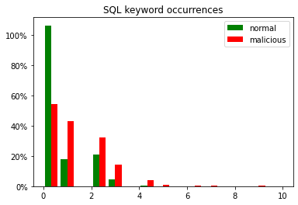
Approach 1: features

Slide 6
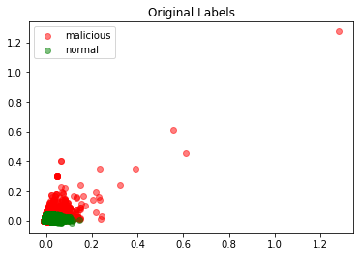
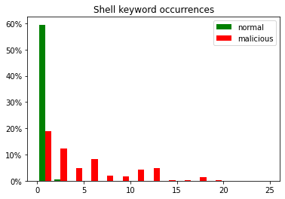
Approach 1: features

Slide 7
Approach 1: Classification
Classifier, F1-Score:
Decision Tree 0.888
MLPClassifier 0.866
Naive Bayes 0.815
Logistic Regression 0.795
SVM 0.759

Slide 8
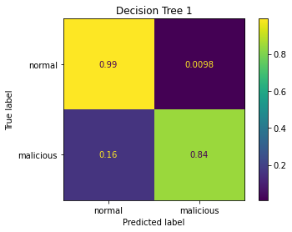
Approach 1: Decision Tree
Precision: 0.749
Accuracy: 0.985
Recall: 0.841
F1-Score: 0.792

Slide 9
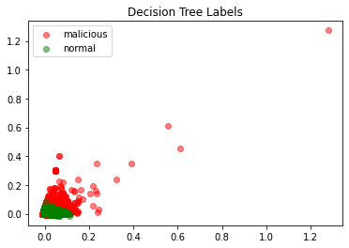
Approach 1: Analysis

Slide 10
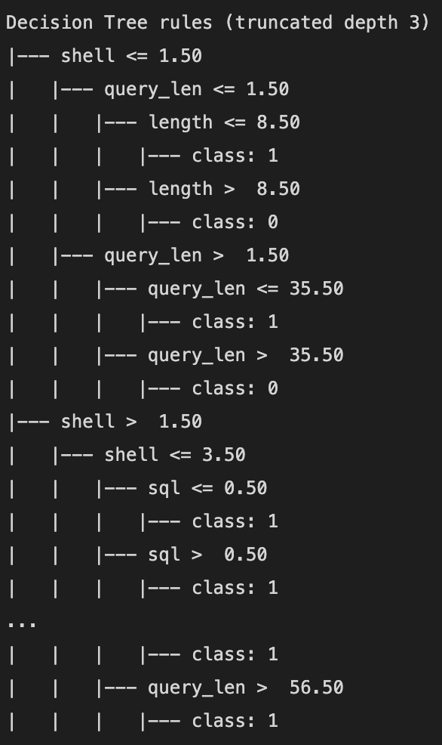
Approach 1: Analysis
Decision Tree features importance:
shell: 71.03%
query_len: 18.63%
length: 5.41%
script: 3.14%
sql: 1.78%

Slide 11
Approach 2: Tfidf Vector
Comparison:
pvalue: 0.00195
Classifier, F1-Score:
SVM 0.998
Logistic Regression 0.990
Classifier, F1-Score
MLPClassifier 0.993
SVM 0.991
Logistic Regression 0.983
Decision Tree 0.962
Naive Bayes 0.890

Slide 12
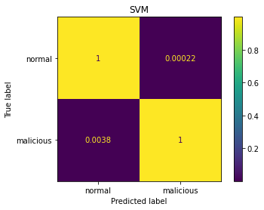
Approach 2: SVM
Precision: 0.993
Accuracy: 0.999
Recall: 0.996
F1-Score: 0.994

Slide 13
Approach 2: Decision Tree
'=', ')' and '>' used in various type of injection attacks
'.ex' part of the string ".exe"
'=ht': part of the string '=http', used in HTTP header injection
'..' used in path traversal and Shell Injection
'pts': part of the string '/scripts', related with PHP-based attacks
" ' " used in SQL Injection
'ipt': part of the string 'script' used in JSInjection
Decision Tree features importance
'=': 43.17%
')': 13.64%
'=ht': 10.25%
'.ex': 6.64%
'<': 5.05%
'..': 2.87%
'pts': 2.72%
" ' ": 1.96%
'ipt': 1.88%
'fiu': 1.32%

Slide 14
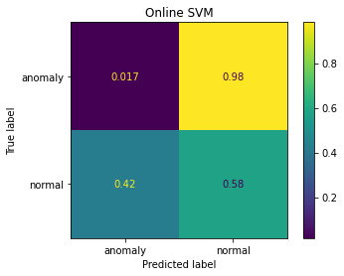
Approach 3: Novelty Detection
Precision: 0.708
Accuracy: 0.356
Recall: 0.412
F1-Score: 0.521

Slide 15
References and Credits
Project’s repo on Github: https://github.com/ivansarno/url-classification
Original Dataset: https://github.com/faizann24/Fwaf-Machine-Learning-driven-Web-Application-Firewall

